Slide 1
9.3 Foreign and Domestic Risk-Neutral Measures
指導教授：戴天時
報告者： 陳博宇

Slide 2
章節架構
9.3.1 The Basic Processes
9.3.2 Domestic Risk-Neutral Measure
9.3.3 Foreign Risk-Neutral Measure
9.3.4 Siegel’s Exchange Rate Paradox
9.3.5 Forward Exchange Rates
9.3.6 Garman-Kohlhagen Formula
9.3.7 Exchange Rate Put-Call Duality

Slide 3
Prices under different numeraires
 | Domestic money market | stock | Foreign money Market
Domestic currency | M(t) | S(t) | Mf(t)Q(t)
Domestic money market | 1 | D(t)S(t) | D(t)Mf(t)Q(t)
Foreign currency | M(t)/Q(t) | S(t)/Q(t) | Mf(t)
Foreign money market | M(t)Df(t)/Q(t) | Df(t)S(t)/Q(t) | 1

Slide 4
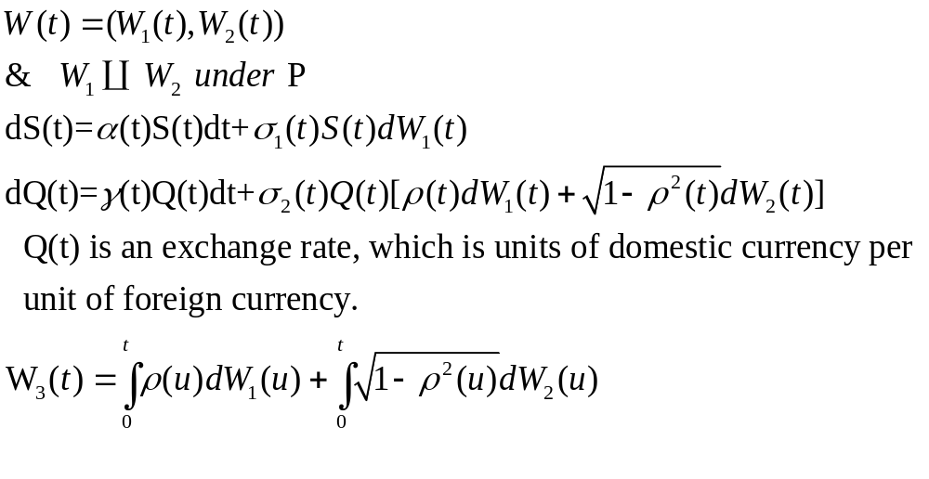
9.3.1 The Basic Processes
首先我們要先定義以下的過程

Slide 5
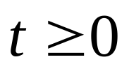
Levy’s Theorem
Let M(t), be a martingale relative to a filtation F(t),
1.M(0)=0
2.M(t) has continuous paths
3. dM(t)dM(t)=t
➔ M(t) is a Brownian motion

Slide 6
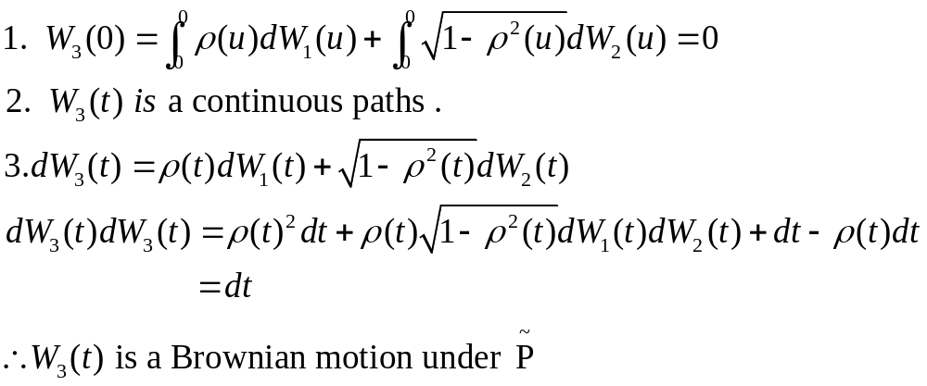
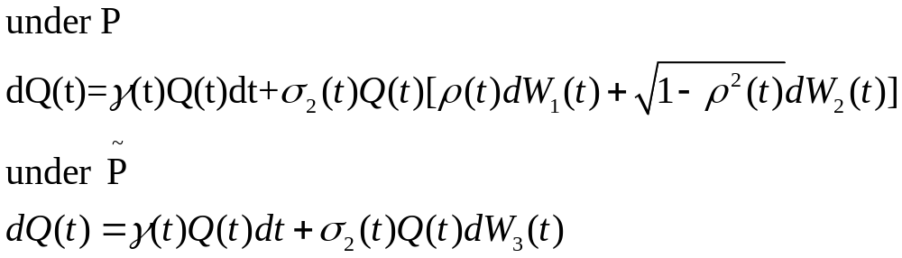

Slide 7
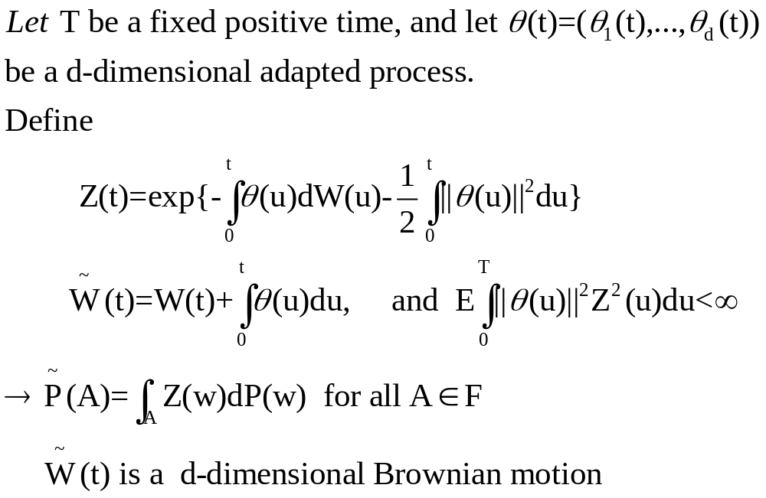
Girsanov’s Theorem

Slide 8
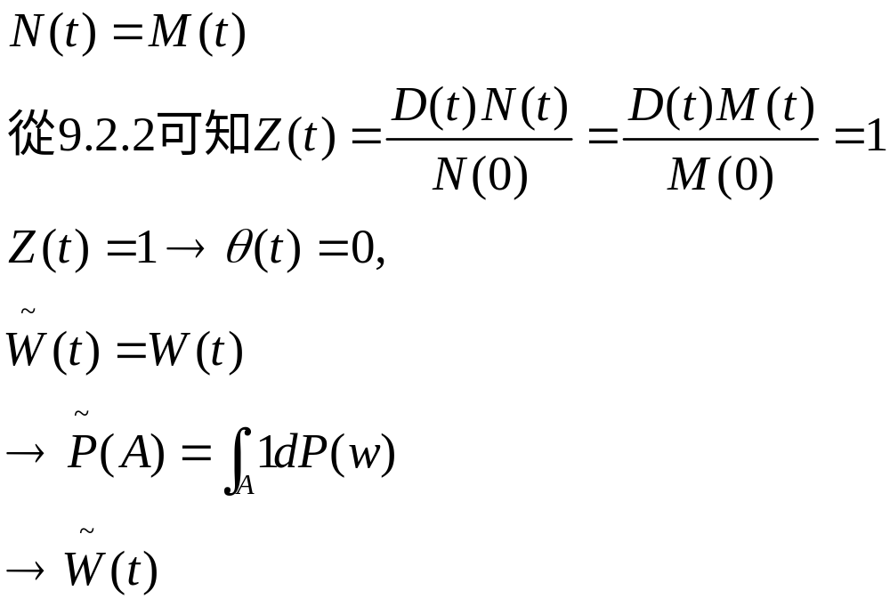

is a Brownian motion under

Slide 9
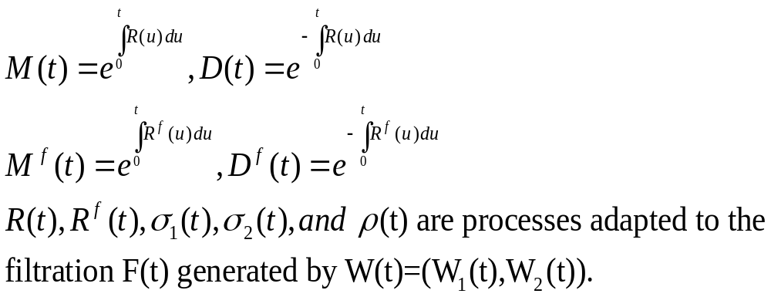

Slide 10
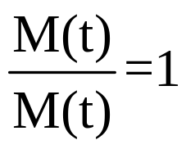
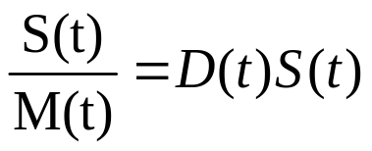
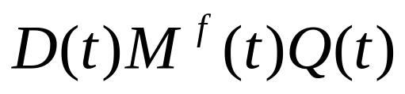
9.3.2 Domestic Risk-Neutral Measure
There are three assets that can be traded
1. Domestic money market account
2. Stock
3. Foreign money market account
使這三個資產在國內風險中立世界裡都是martingale

Slide 11
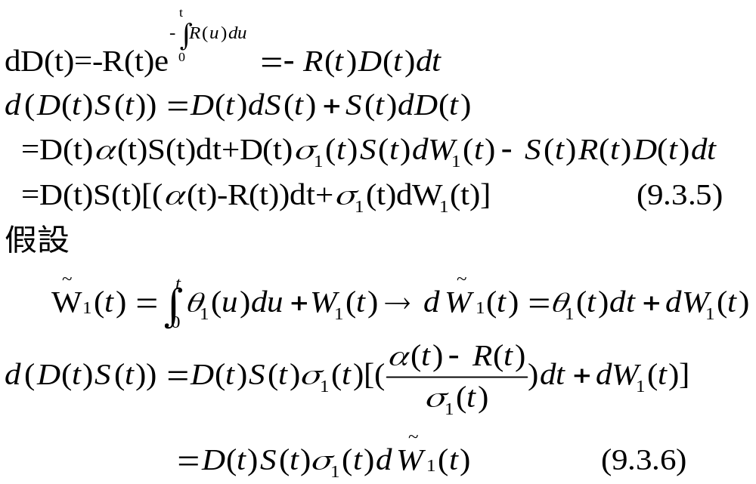
在stock部分

Slide 12
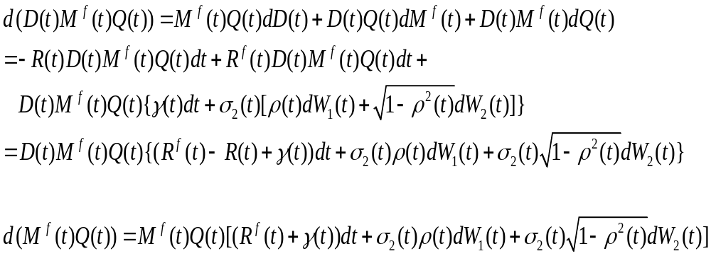
在foreign money market account(1)
By Ito lemma

Slide 13
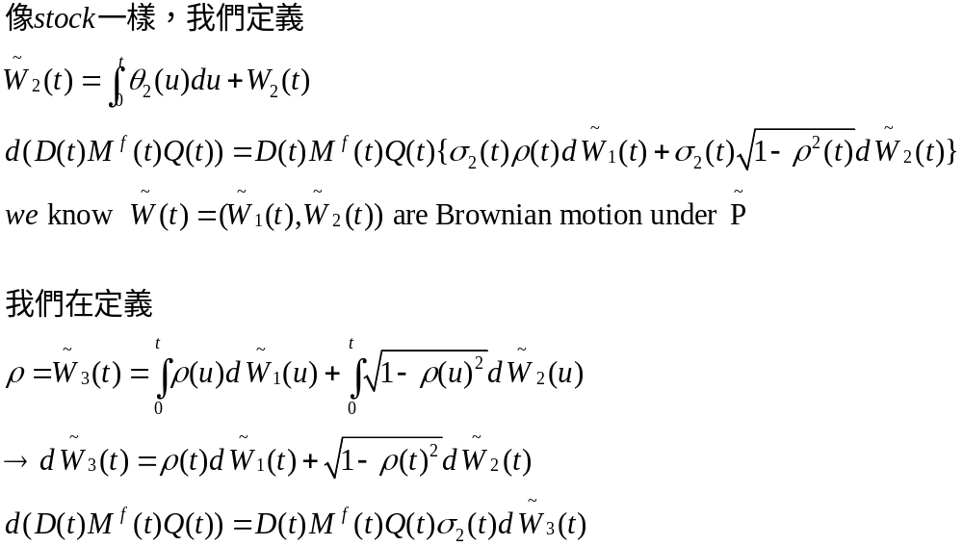
在foreign money market account(2)

Slide 14
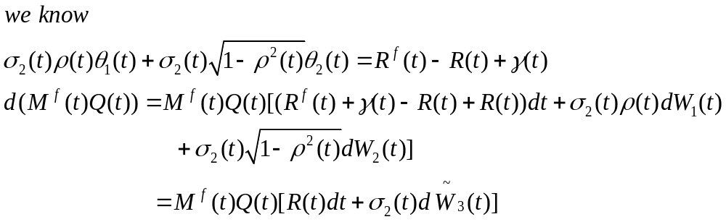
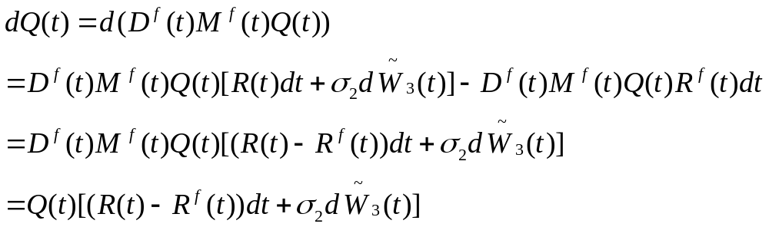
By Ito lemma

Slide 15
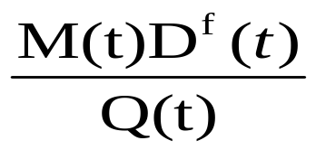
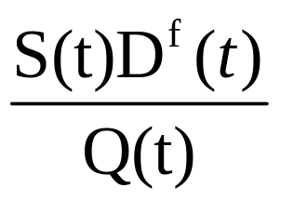
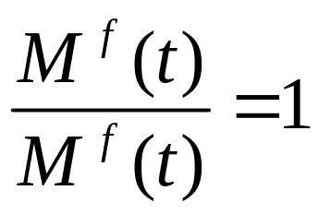
9.3.3 Foreign Risk-Neutral Measure
There are three assets that can be traded
1. Domestic money market account
2. Stock
3. Foreign money market account
使這三個資產在國外風險中立世界裡都是martingale

Slide 16
Girsanov’s Theorem

Slide 17
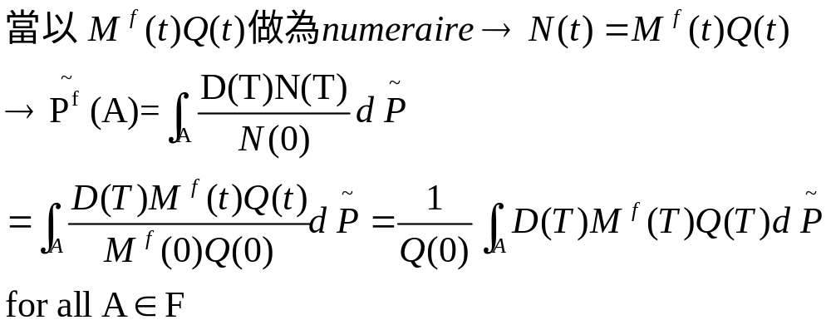

Slide 18
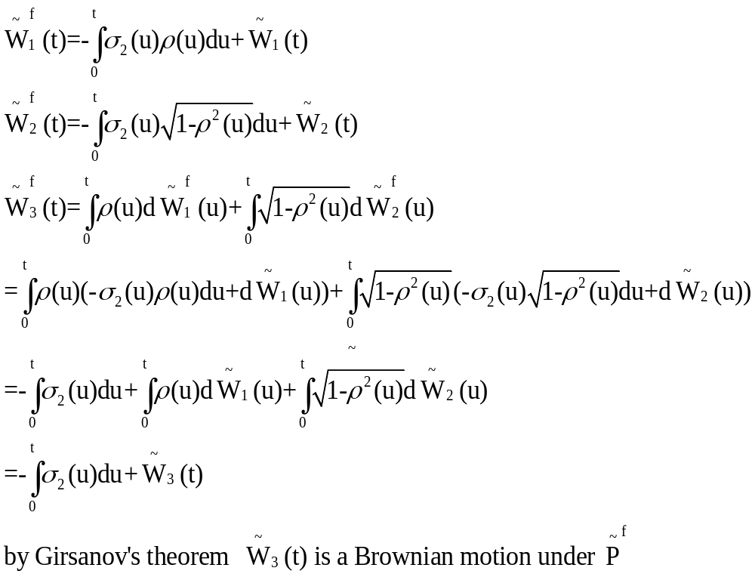

Slide 19
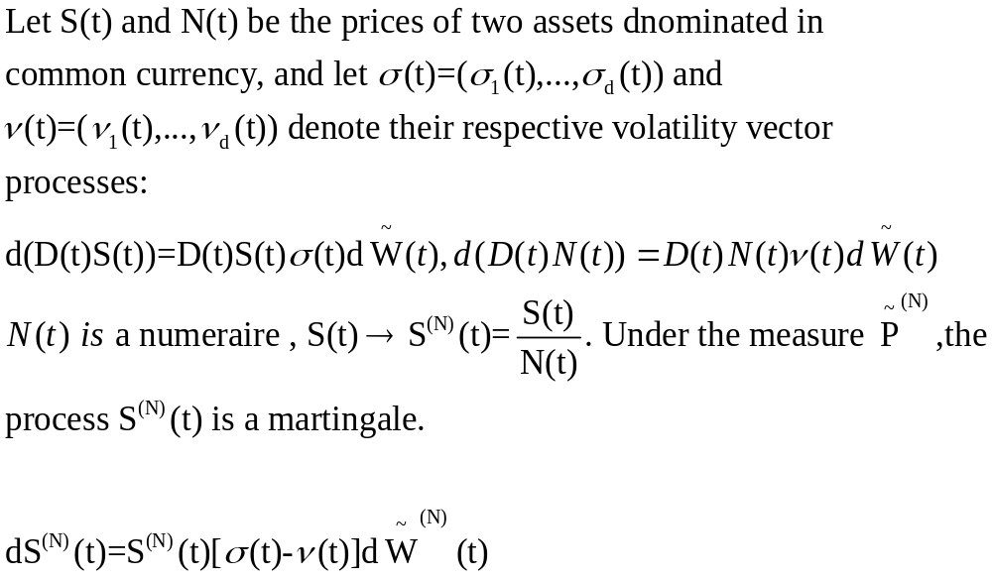
Theorem 9.2.2

Slide 20
